Slide 1
Unmanaged Scenario

Slide 2


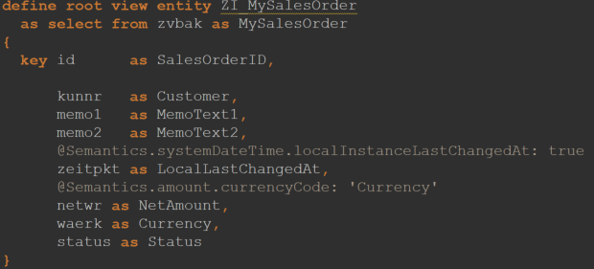
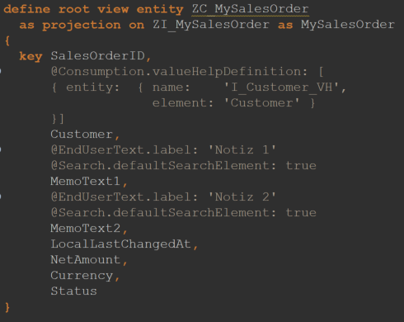
Create CDS Views
Create CDS Projection Views
Nothing changes in the definition of the CDS views

Slide 3


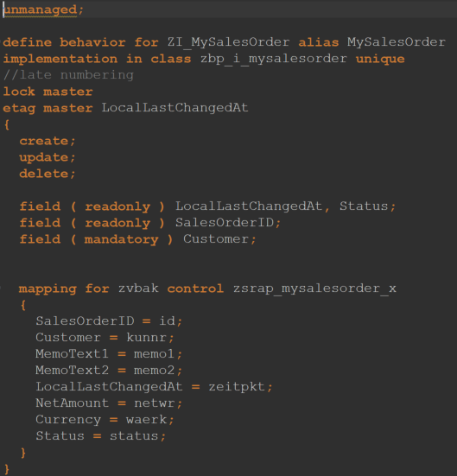
Create Behavior Definition
Create Behavior Class
Create behaviour definition for entities
Unmanaged
Create the implementation class as for managed

Slide 4

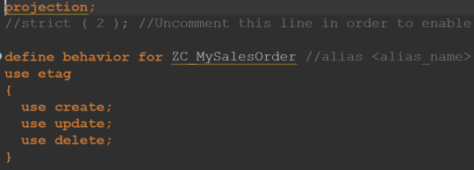
Create Behavior Projection
Create projections of the behaviour definitions
Specify CRUD operations

Slide 5



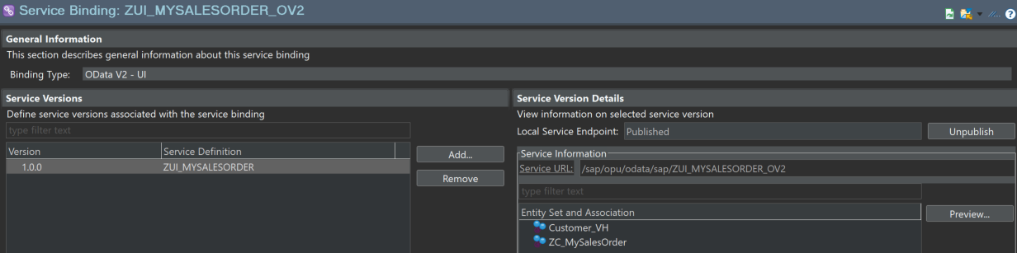
Create Service Defintion
Create Service Bindung
Create service definition and binding (ODATA V2)
In Service Binding, click on ZC_SFLIGHT and then on Preview

Slide 6
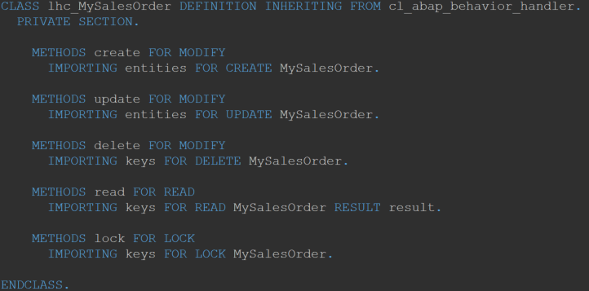
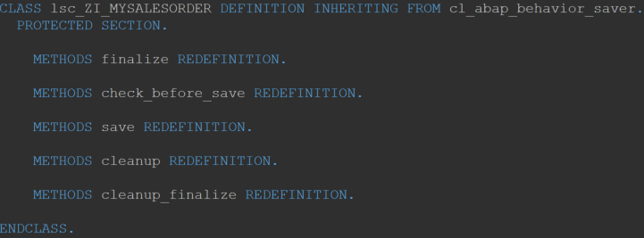
CRUD
CRUD operations and management of the transaction buffer and the memory sequence must be implemented manually.
This is how existing code can be integrated

Slide 7
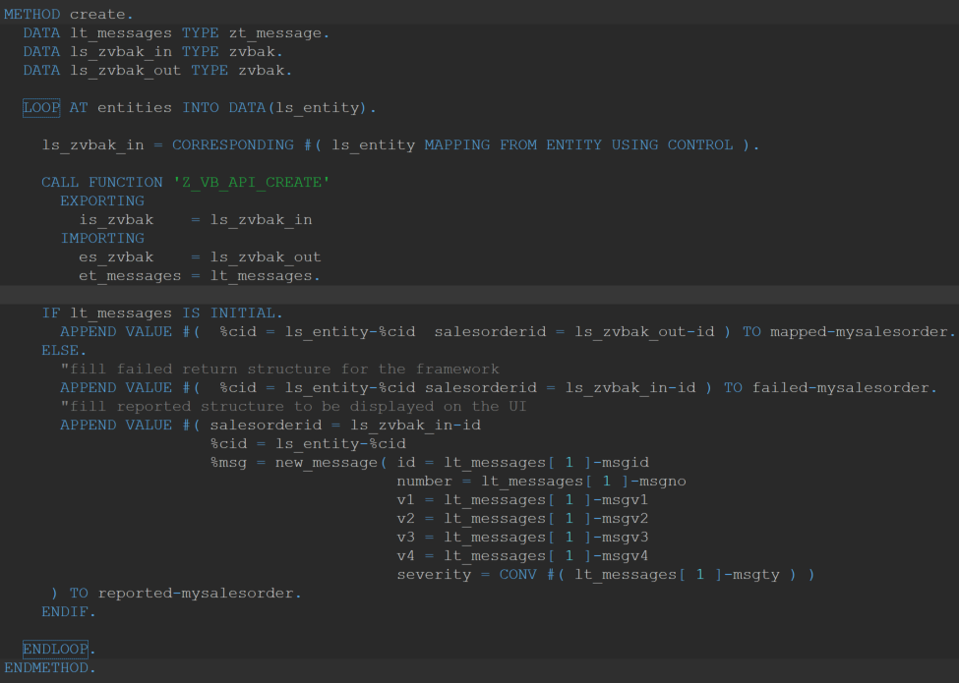
Create (as an example)
Method create calls function module Z_VB_API_CREATE to create an instance of the entity VBAK

Slide 8
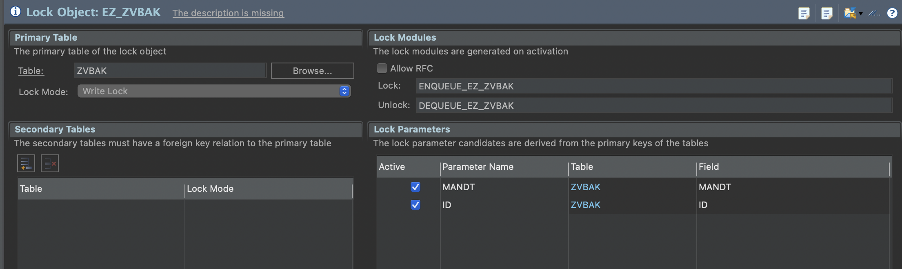
Info: Lock Object

Slide 9
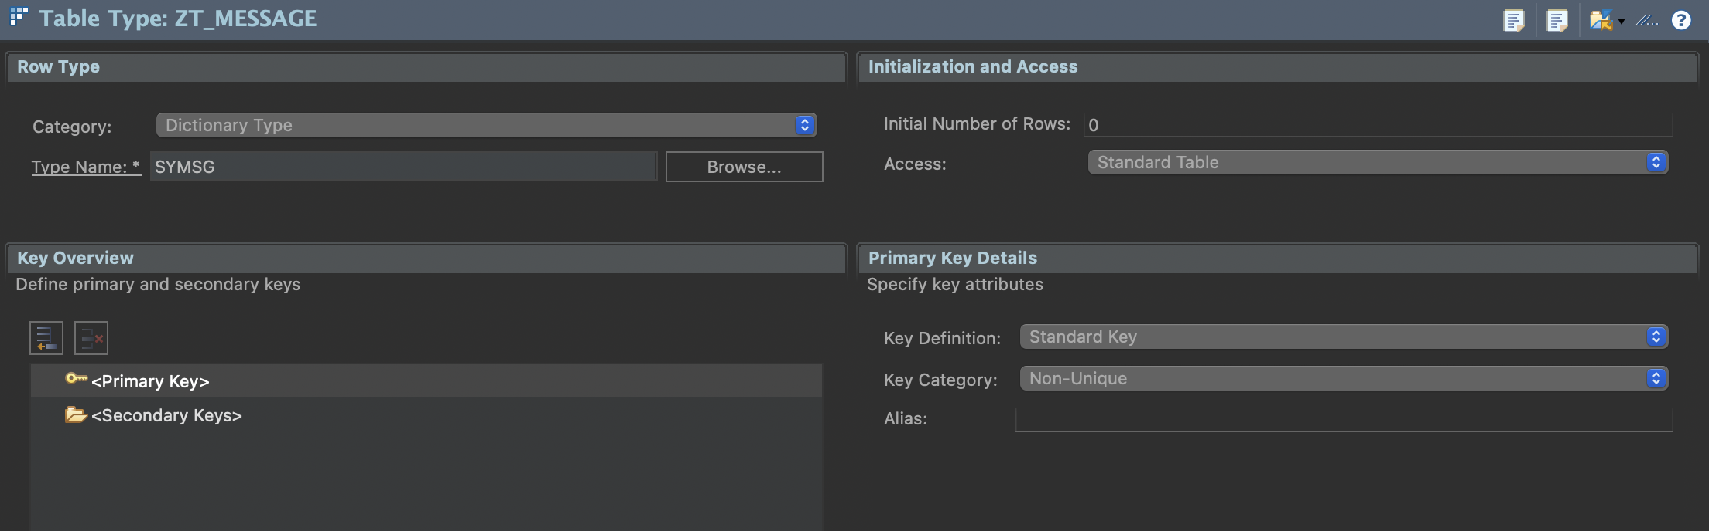
Info: Table Types

Slide 10
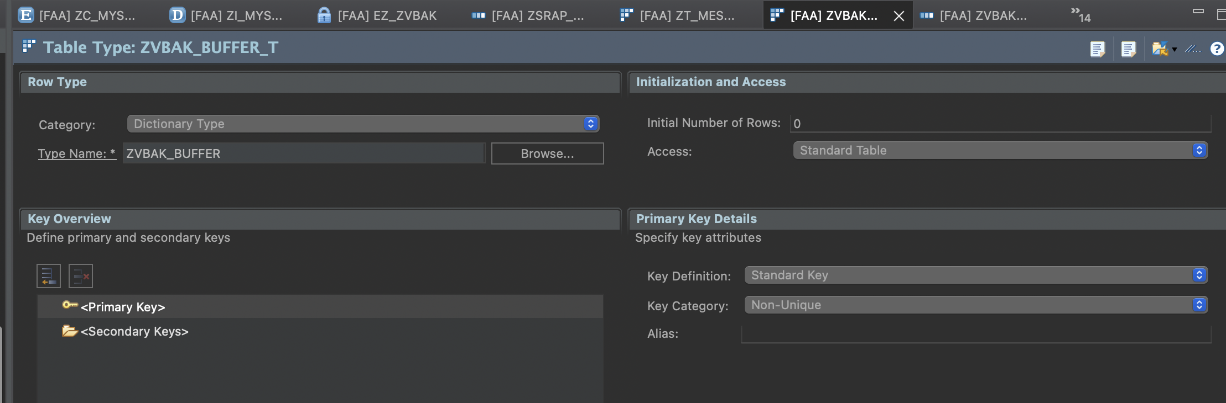
Info: Table Types

Slide 11
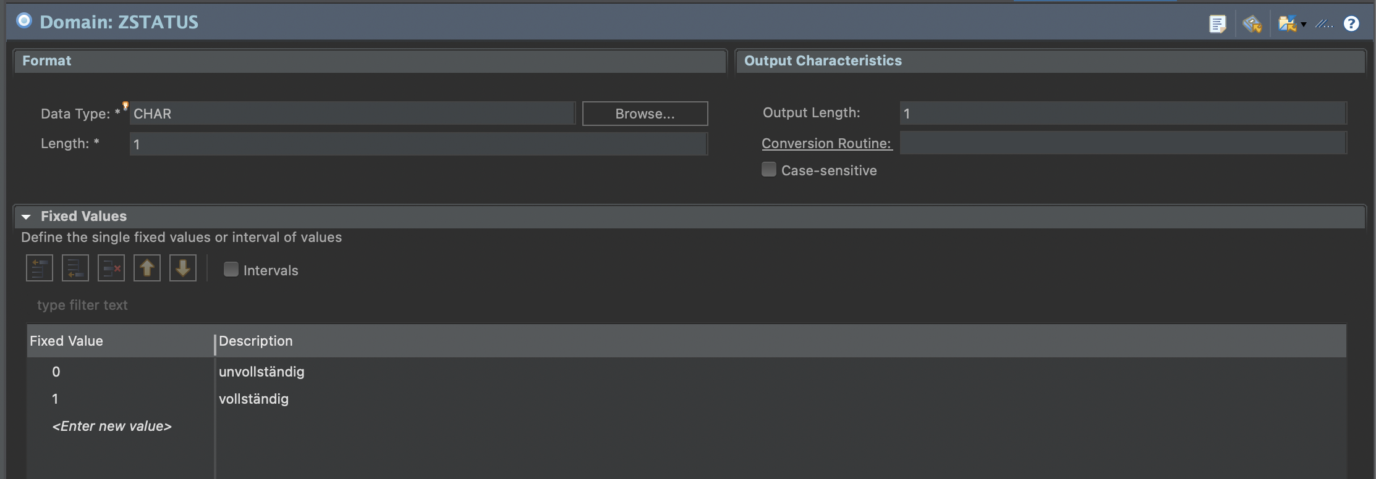
Info: Domain

Slide 12
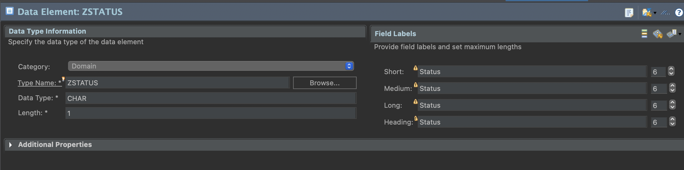
Info: Data Elements

Slide 13
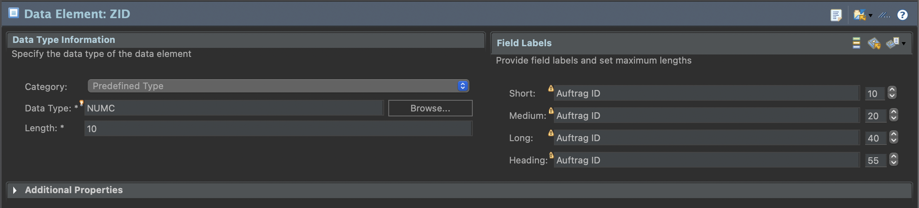
Info: Data Elements

